Slide 1
Learning Distributed Representations of Sentences from Unlabelled Data
Tiantong Wang

Slide 2
Distributed Representation
Design dense real-value vectors to encode linguistic units.
Map the vocabulary list into a chosen space, such that the distance between two represent vectors can mostly reflect the difference of meanings of the represented units.
Unit could be word, term, phrase, or sentence.

Slide 3
Representation Of Phrases And Sentences
There are numerous methods that can learn the representation of words and terms. People have good understanding of them, both empirically and theoretically.
However, methods that learn representations of phrases and sentences are not so carefully studied yet.

Slide 4
Main Task
The paper makes comparison of several different distributed sentence representation learning methods that do not require labeled data.
This paper also presents two new models to learn sentence representation:
1. Sequential Denoising Autoencoders (SDAEs)
2. FastSent

Slide 5
Existed Models

Slide 6
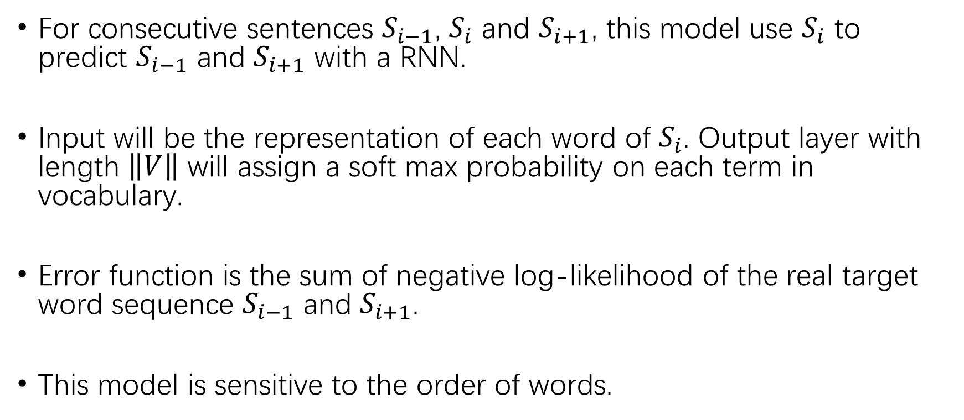
SkipThought Model
For consecutive sentences $S_{i−1}$, $S_{i}$ and $S_{i+1}$, this model use $S_{i}$ to predict $S_{i−1}$ and $S_{i+1}$ with a RNN.
Input will be the representation of each word of $S_{i}$. Output layer with length $\left\|V\right\|$ will assign a soft max probability on each term in vocabulary.
Error function is the sum of negative log-likelihood of the real target word sequence $S_{i−1}$ and $S_{i+1}$.
This model is sensitive to the order of words.

Slide 7
ParagraphVector Model
2 log-linear models, DBOW and DM.
DBOW learns a vector for every sentence in the training corpus which, together with word embedding, also define a softmax distribution optimized to predict words in a given sentence. The word embeddings are shared for all sentences.
In DM, a k-gram is selected from the sentence and the representation of sentence learned in DBOW and the word embedding are combined to give a softmax prediction for the word next to the k-gram.

Slide 8
Bottum-Up Methods
CBOW and Skip-Gram word embeddings
C-PHRASE
Baseline: TF-IDF BOW

Slide 9
Models On Structured Resources

Slide 10
DictRep Model
Train a neuron network to map dictionary definitions to pre-trained word embeddings of the words defined by those definitions.
Apply BOW and RNN (with LSTM) to encode architectures.

Slide 11
CaptionRep
Map captions in the COCO dataset to pre-trained vector representations of images encoded by a deep convolutional network trained on the ILSVRC 2014 object recognition task.

Slide 12
NMT
Same structure with SkipThought, but are trained on sentence-aligned translated texts.

Slide 13
New Model Presented

Slide 14
Sequential Denoising Autoencoders
SkipThought requires the sentences to be coherent, which sometimes cannot be satisfied.
Denoising autoencoders learn to represent the data in terms of features that explain its important factors of variation, like regressions.

Slide 15
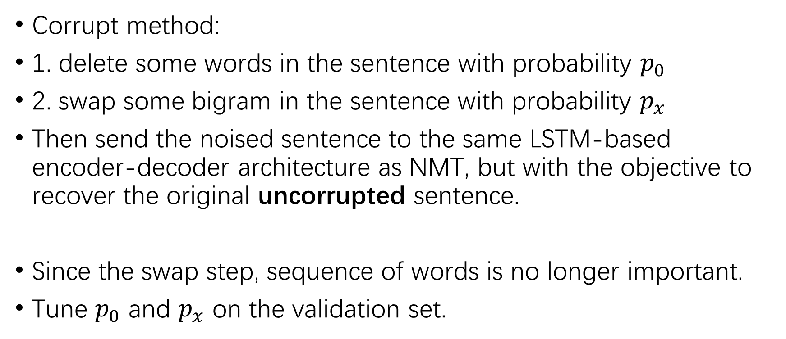
Sequential Denoising Autoencoders
Corrupt method:
1. delete some words in the sentence with probability $p_{0}$
2. swap some bigram in the sentence with probability $p_{x}$
Then send the noised sentence to the same LSTM-based encoder-decoder architecture as NMT, but with the objective to recover the original uncorrupted sentence.
Since the swap step, sequence of words is no longer important.
Tune $p_{0}$ and $p_{x}$ on the validation set.

Slide 16
FastSent
Hypothesis: SkipThought shows that sentence semantics can be inferred from their context.
FastSent apply a log-linear model to achieve the same representations as SkipThought, but with much smaller computational expense.
Use a BOW representation of a sentence to predict the BOW representation of the neighborhood sentences.

Slide 17



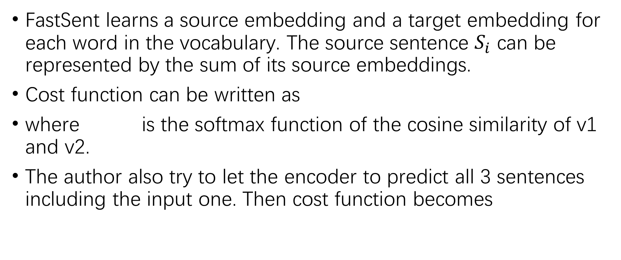
FastSent
FastSent learns a source embedding and a target embedding for each word in the vocabulary. The source sentence $S_{i}$ can be represented by the sum of its source embeddings.
Cost function can be written as
where is the softmax function of the cosine similarity of v1 and v2.
The author also try to let the encoder to predict all 3 sentences including the input one. Then cost function becomes

Slide 18
Words that do not appear in the sentence should be assign small probability?

Slide 19

Softmax Function
A softmax function can produce a probability distribution over a number of elements or vectors.

Slide 20
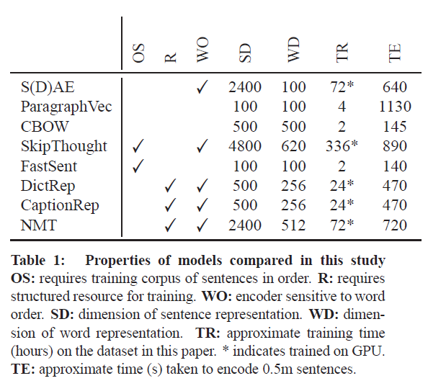
Dimensions & Training Speed

Slide 21
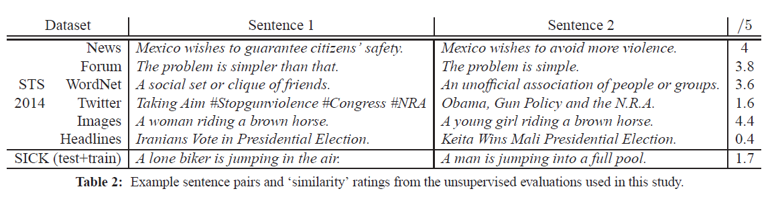
Example
Example sentences with similar representation

Slide 22
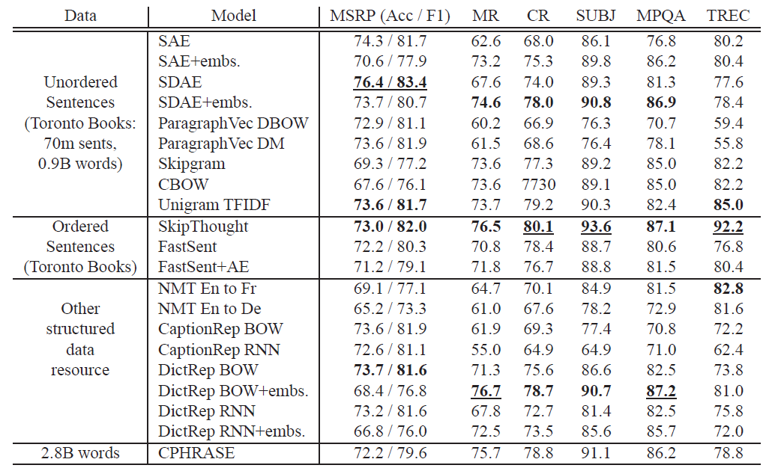
Evaluation
Use both supervised and unsupervised dataset to do the evaluation.
Supervised Result

Slide 23
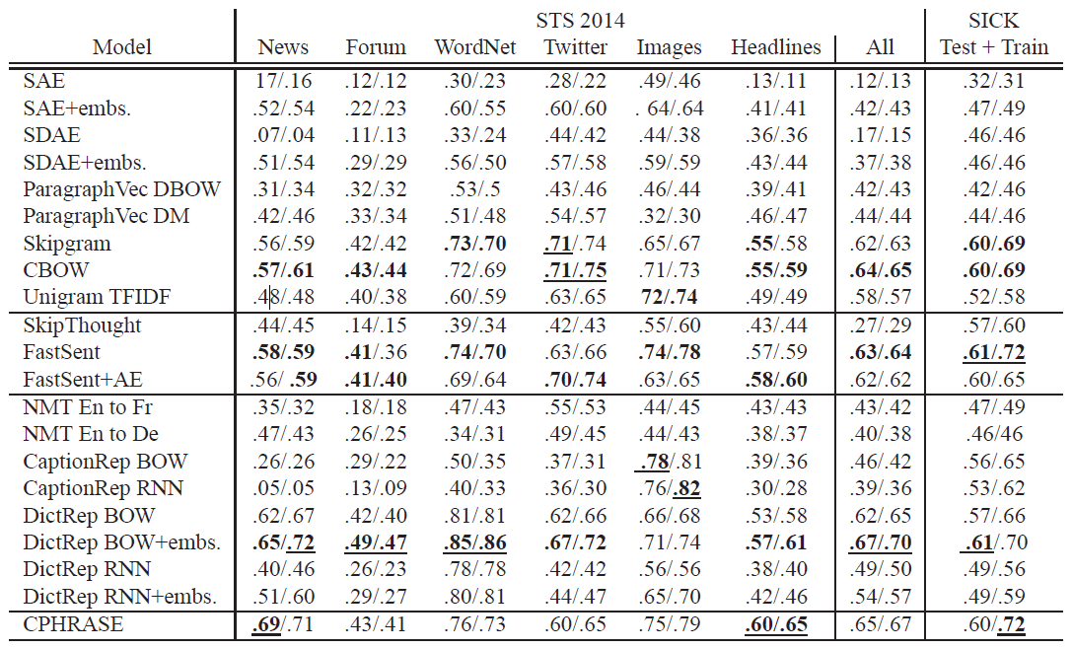
Evaluation
Use both supervised and unsupervised dataset to do the evaluation.
Unsupervised Result

Slide 24
Discussion
Different performance between supervised and unsupervised data: Cosine similarity might not be a good measurement.
Resource taste are different for different models.
The influence of words order is still unclear.
Evaluations have limitations: supervised and unsupervised training have different preference of properties.

Slide 25
Thank you !

